Slide 1
CMP3103M Autonomous Mobile Robotics Assessment Item 1
Peter Hart | 12421031

Slide 2
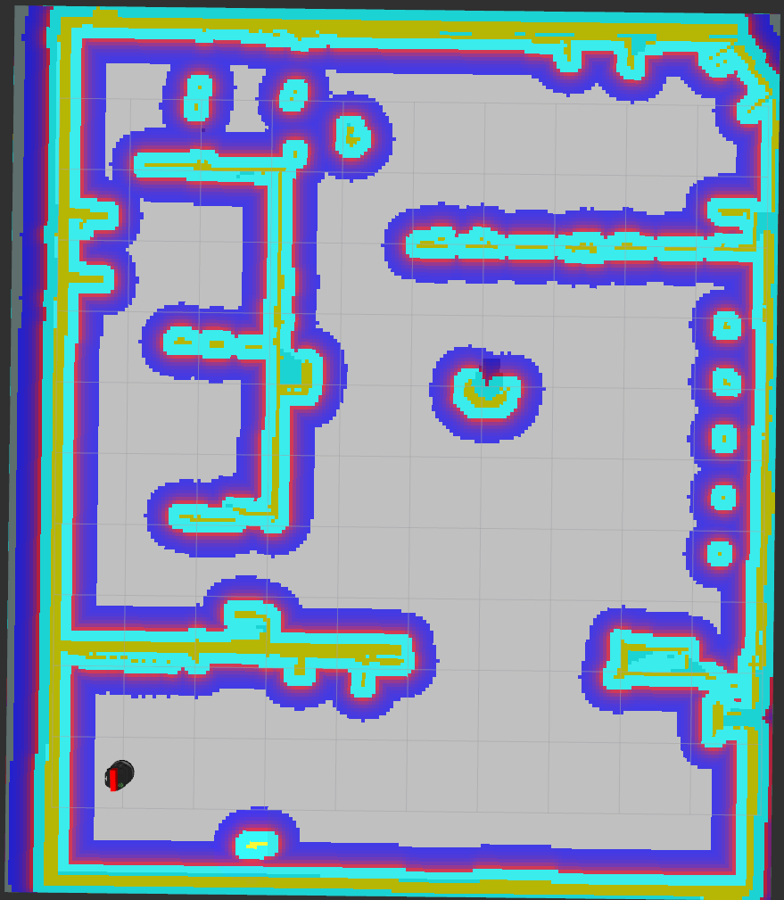
System Design
For each Node on the topological map
Calculate a path to the currently selected Node using a Dijkstra’s algorithm
Travel to that Node
Iterate to the next Node
Once the Turtlebot has reached the current Node, look for a coloured object
If the Turtlebot can observe one of the objects within the current Node
If the Turtlebot can’t observe one of the objects within the current Node
Travel to the coloured object
Stop searching for a coloured object at the current Node
Flag that coloured object, and ignore it in the mask when performing subsequent observations
Iterate to the next Node

Slide 3
System Performance
Results:
Is capable of locating all four coloured objects within the training arena
Usually performs the search in around 5 minutes
Is capable of identifying each of the objects uniquely with high accuracy
Noted Shortcomings:
A* algorithm for the path planning may have been more appropriate for implementation as opposed to utilising the Dijkstra’s algorithm

